Slide 1

Determination of
Integrating Factor
Available at:
http://asia.groups.yahoo.com/groups/math24_fourthterm_SY0910
Notes:
h24

Slide 2
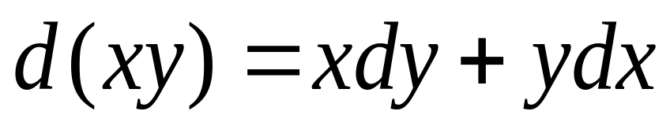
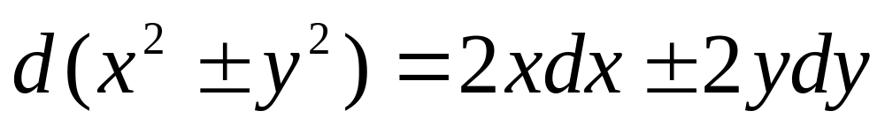
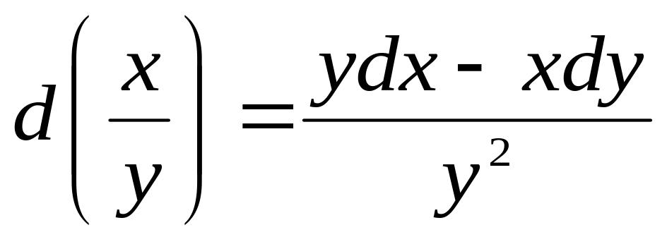
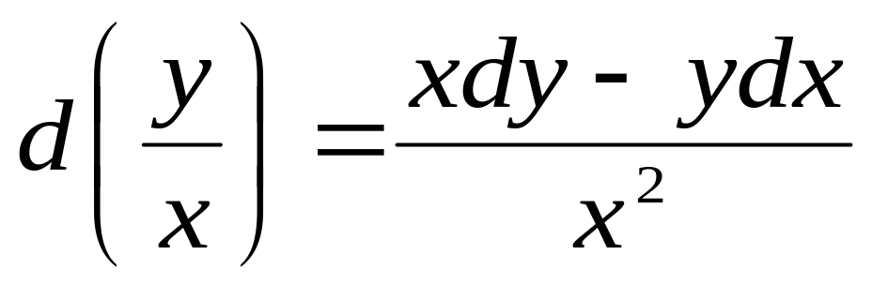
Method of Inspection
Total differentials Formulas:

Slide 3
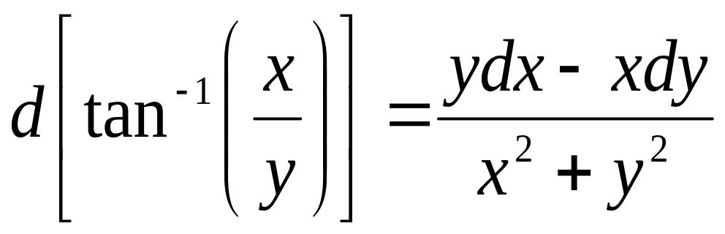
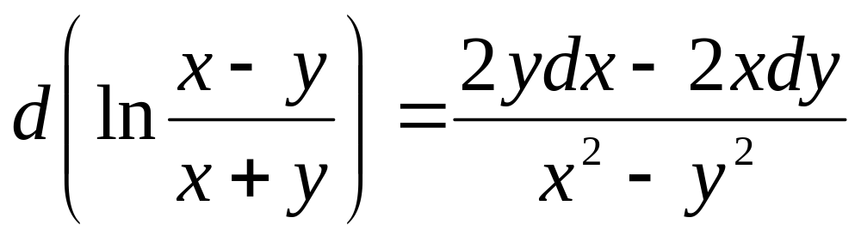
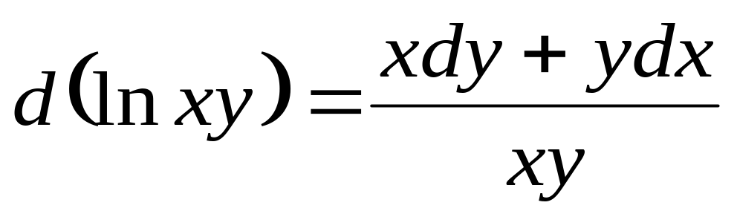
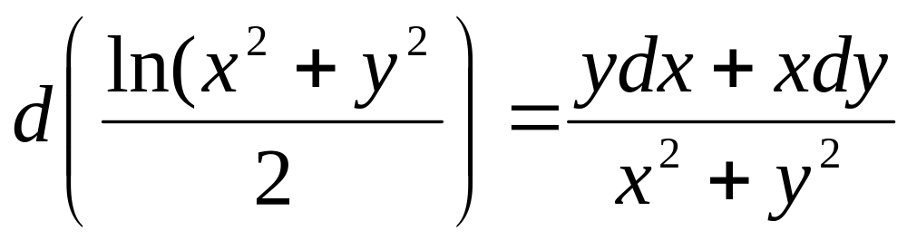
Method of Inspection
Total differentials Formulas:

Slide 4
Example
xdy + ydx = 3x² dx
use:

Slide 5
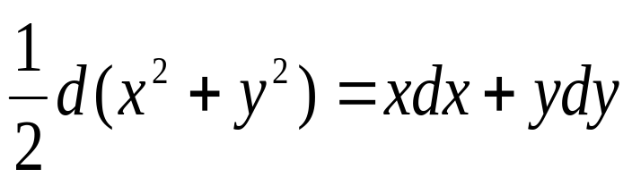
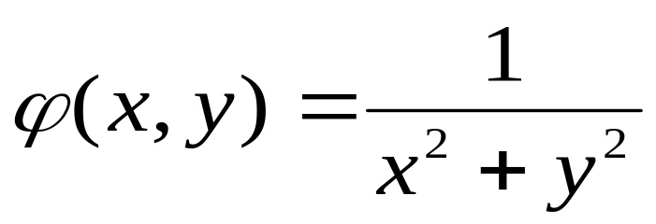
Example
2. ydx – xdy = (x² + y²)(xdx + ydy)
use:
and
Integrating Factor:

Slide 6
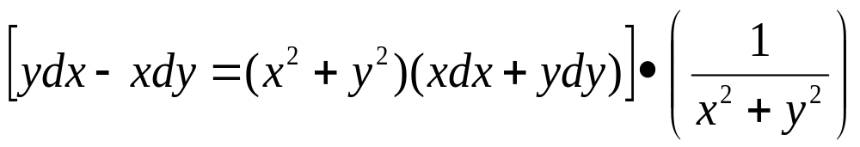
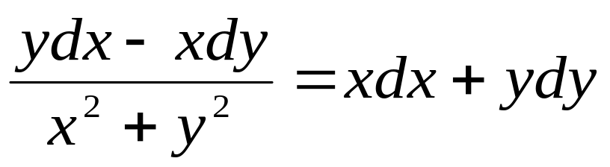
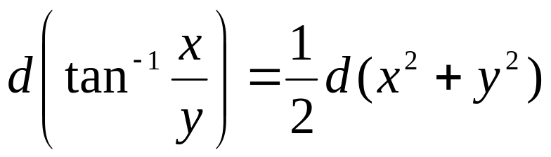
Example
2. ydx – xdy = (x² + y²)(xdx + ydy)

Slide 7
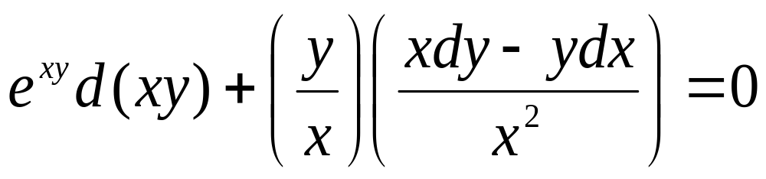
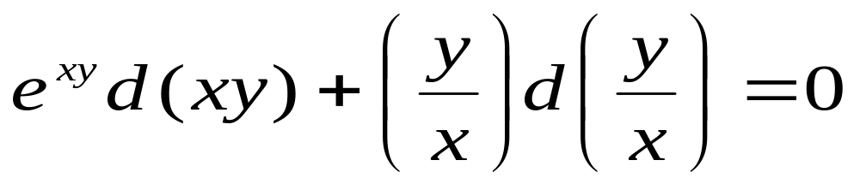
Example
3. y(x³e^{xy}-y)dx + x(y + x³e^{xy})dy = 0
yx³e^{xy}dx – y²dx + xydy + x⁴e^{xy}dy = 0
(yx³e^{xy}dx + x⁴e^{xy}dy) + (xydy – y²dx) = 0
x³e^{xy}(ydx + xdy) + y(xdy – ydx) = 0
Use: φ(x) = x⁻³
e^{xy}(ydx + xdy) + x⁻³y(xdy – ydx) = 0

Slide 8
Example
4. y²(1 – x²)dx + x(x²y + 2x + y)dy = 0

Slide 9
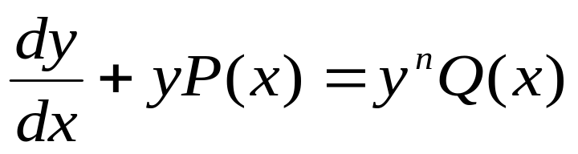
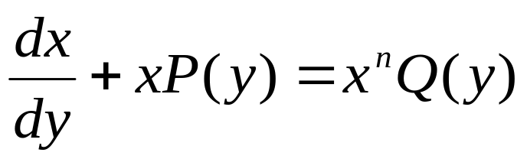
Bernoulli Equation
General Forms:
Bernoulli in y:
Bernoulli in x:
If n = 1, then solve the DE by separation.
If n = 0, then solve the DE as a FOLDE.

Slide 10
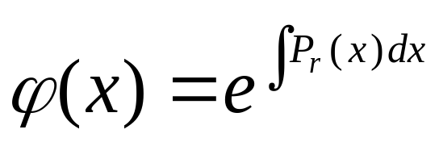
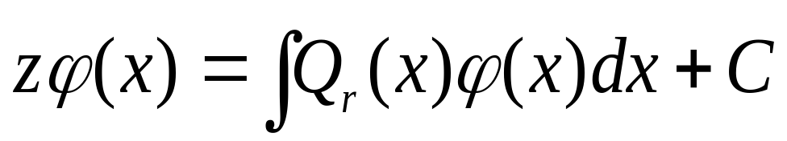
Bernoulli Equation
Bernoulli in y:
Procedure:
1. Let z = y^{1-n}
P_{r}(x) = (1 – n)P(x)
Q_{r}(x) = (1 – n)Q(x)
2. Find integrating factor
3. Determine the general solution

Slide 11
Examples
(2y² + yx)dx – x²dy = 0
(x³y² + xy)dx = dy
xy(1 + xy²)dy = dx

Slide 12
Introduction

Slide 13
Basic Concepts
STATISTICS
Descriptive
Inferential
Collection, organization, presentation, computation and interpretation
Methods and processes concerned with analysis of smaller group of data leading to inferences about the larger set of data

Slide 14
Basic Concepts
Population vs Sample
Population
(parameter)
Sample
(statistic)
Notes:
To understand fully the 2 main divisions of statistics, let us distinguish a sample from a population. Population is the totality of objects, individuals or any data source which have common observable characteristics. A part or subset of the population is called a sample. It is basically used to give inferences on the population from which it is drawn.
Any numerical value describing the characteristics of a population is termed as parameter, and to that of a sample is known as statistic. These characteristics include among others the measures of central location (mean, median, and mode), measures of position (quantiles) and measures of variation (range, variance, standard deviation).

Slide 15
Examples
Classify the following statements as belonging to the area of descriptive statistics or statistical inference.
As a result of recent cutbacks by oil producing nations, we can expect the price of gasoline to double next year.
2. Based on the 5 units tested, the shipment of all electronic equipment is proven to be shock proof.
3. At least 5% of all fires reported last year in a certain city were deliberately set by arsonist.
4. Recent survey results show that female students prefer wearing pants over skirts on a certain university.
Notes:
The statement is an inference since no data was presented as to come up with such statement.
The statement is a statistical inference since the data presented is small as compared to the actual data that was shipped to the location.
The statement is descriptive statistics since a figure was presented, the 5%, to describe the event.
The statement is descriptive statistics since a survey was conducted in order for all of the respondents to describe the event.

Slide 16
Types of Data
According to Source:
Primary:
- acquired through experiments, data gathering devices,
interviews, and surveys.
2. Secondary:
- data gathered from recorded or printed materials
such as books, magazines and journals
According to numeracy:
Qualitative or Categorical: non-numeric form
examples) gender, color, civil status, sex, race, religion,
degree course, residence
2. Quantitative or Numeric: countable or measurable
examples: scores, weight, height, numeric grades,
temperature, IQ level
Notes:
The strength of the data on making conclusions is significant in inferential statistics. These sources can be generally grouped as primary source of data and secondary source of data.
Data collected maybe quantitative or qualitative in form. Categorical Data are commonly answered by non numeric data usually qualitative in form. Numerical Data are information and observations that are countable or measurable quantities.

Slide 17
Measurements of Data
Nominal Measurement
– used for identification or classification purposes (unordered)
examples:
a) courses may be coded as: 1 – engineering; 2 – architecture;
3 – nursing; 4 – IT
b) gender coded as : Male – 1; Female – 0
c) zip codes
2. Ordinal Measurement
– gives the order or rank of the objects or items (ordered)
examples: ranks given to winners in a contest, year level, academic
ranks of professors
3. Interval Measurement
– range between numeric values is constant
(additive, not multiplicative)
examples: year, temperature , weight, height
4. Ratio Measurement
– allows determination of ratio in the amounts being measured
(additive, multiplicative)
examples: age, weight, height
Notes:
In statistics, categorical data may be assigned numbers in order facilitate ease of computation and some basic calculations. This process is called measurement. By measurements, numbers are utilized to code objects in order that they can be treated statistically.

Slide 18
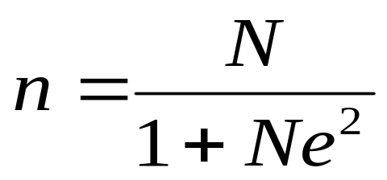
Sampling Techniques
Determining Sample Size: SLOVIN Formula
where: n – sample size; N – population size; e – margin of error
Example:
How large a sample should be chosen if we expect
5% error from a population of 3000?

Slide 19
Basic Concepts

Slide 20
Basic Concepts

Slide 21
Basic Concepts

Slide 22
Basic Concepts

Slide 23
Basic Concepts

Slide 24
Basic Concepts

Slide 25
Basic Concepts

Slide 26
Basic Concepts

Slide 27
Basic Concepts

Slide 28
Basic Concepts

Slide 29
Basic Concepts

Slide 30
Basic Concepts

Slide 31
Basic Concepts

